Slide 1
First plot in Matplotlib

Slide 2
An example plt.plot() function call including line color, line width, and line style options is:
plt.plot(x, y,
linewidth=2.0,
linestyle='+',
color='b',
alpha=0.5,
marker='o')

Slide 3
Legend

Slide 4




Legend & Grid in
https://www.kharwal.com

Slide 5
You can use the plt.legend() command to insert a legend on a plot.
The legend appears within the plot area, in the upper right corner by default.
The plt.legend() command accepts a list of strings and optionally accepts a loc argument to specify the legend location.

Slide 6
Legend Location loc = <number>
'best' 0
'upper right' 1
'upper left' 2
'lower left' 3
'lower right' 4
'right' 5

Slide 7
'center left' 6
'center right' 7
'lower center' 8
'upper center' 9
'center' 10

Slide 8
Grid

Slide 9
A grid can be added to a Matplotlib plot using the plt.grid() command.
By defaut, the grid is turned off.
To turn on the grid use: plt.grid(True)
The only valid options are plt.grid(True) and plt.grid(False).

Slide 10
Tick Label

Slide 11
Tick labels can be specified on a Matplotlib plot using plt.xticks() and plt.yticks().
To add tick labels use:
plt.xticks([locations list],[labels list])
plt.yticks([locations list],[labels list])
The [locations list] can be a Python list or NumPy array of tick locations . The [labels list] is a Python list or NumPy array of strings.

Slide 12
Syntax:
plt.plot(<x-data>,<y-data>,
linewidth=<float or int>,
linestyle='<linestyle abbreviation>',
color='<color abbreviation>',
alpha=<float or int>,
marker='<marker abbreviation>')

Slide 13
An example plt.plot() function call including line color, line width, and line style options is:
plt.plot(x, y,
linewidth=2.0,
linestyle='+',
color='b',
alpha=0.5,
marker='o')

Slide 14

Thank you!
Please like & subscribe our channel.

Slide 22
Types of Plot

Slide 23
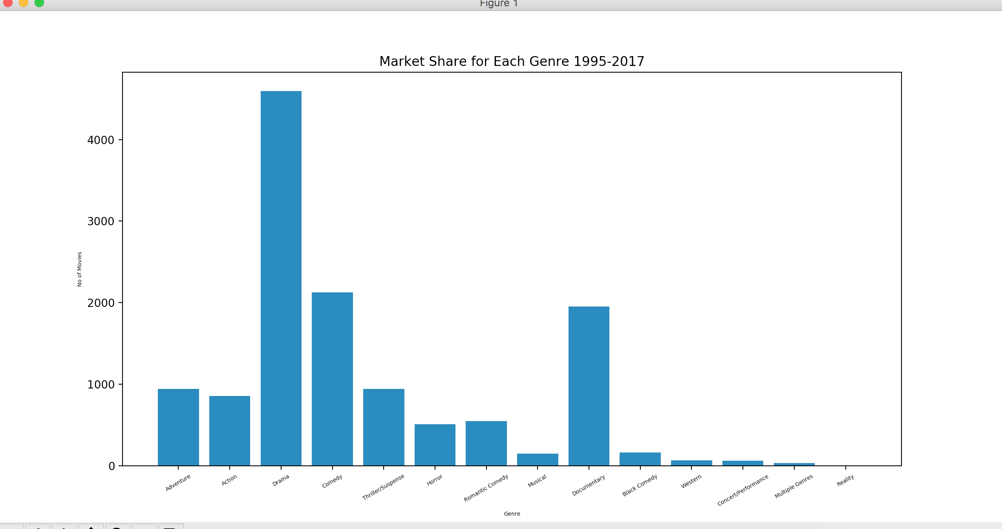
Bar Graph

Slide 24
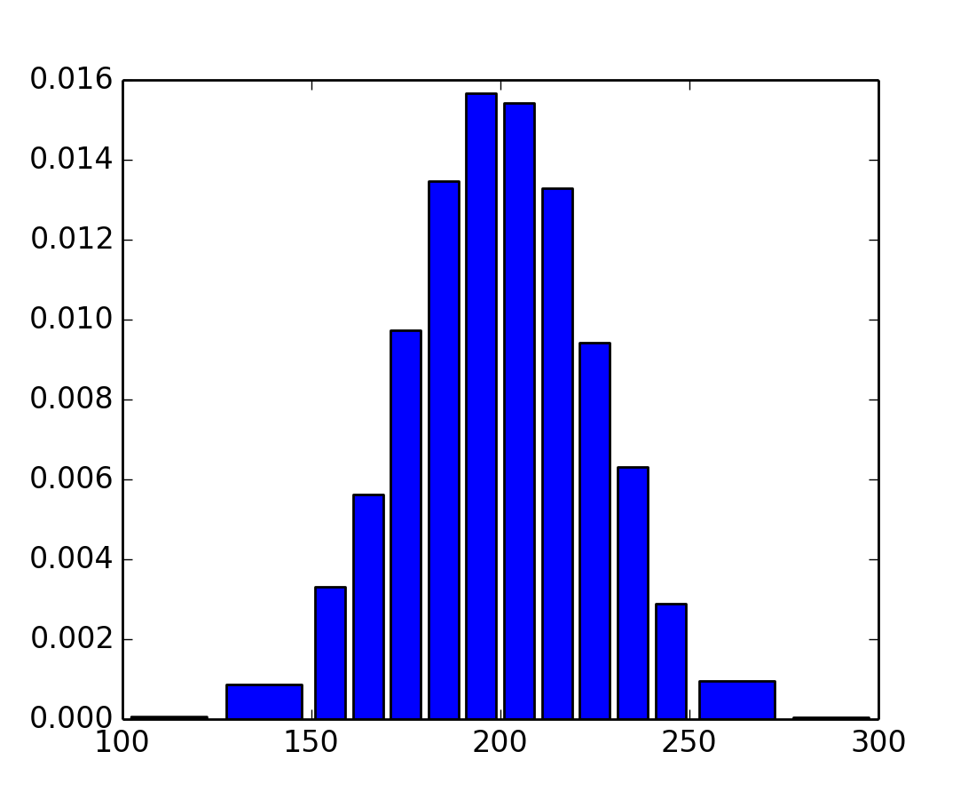
Histogram Graph

Slide 25
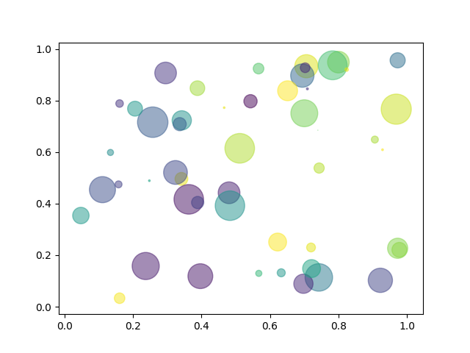
Scatter Plot

Slide 26
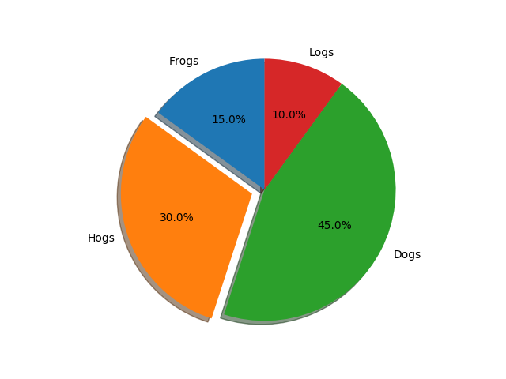
Pie Plot

Slide 27
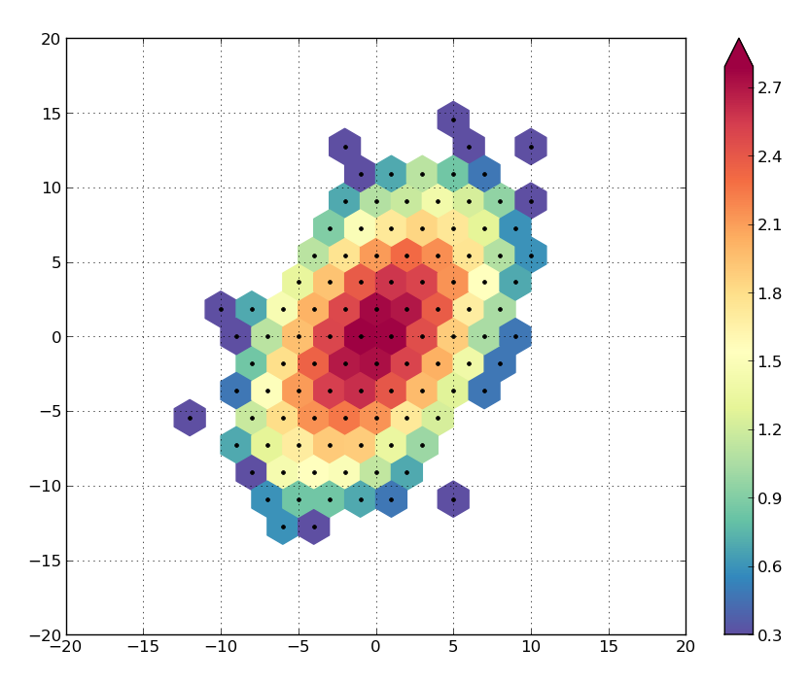
Hexbin Plot

Slide 28
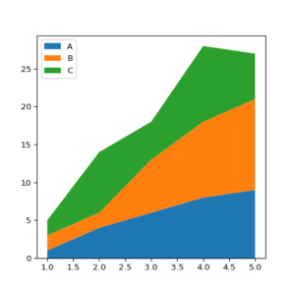
Area Plot

Slide 29
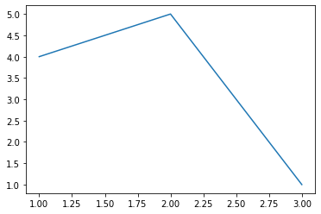
Create First Plot:
from matplotlib import pyplot as plt
plt.plot([1,2,3],[4,5,1])
plt.show

Slide 30
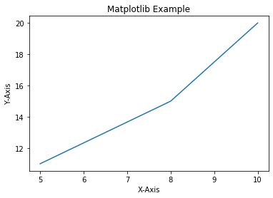
Add Labels and Title to Plot:
from matplotlib import pyplot as plt
x=[5,8,10]
y=[11,15,20]
plt.plot(x,y)
plt.title('Matplotlib Example')
plt.xlabel('X-Axis')
plt.ylabel('Y-Axis')
plt.show()

Slide 31
Add Styles to Plot:
from matplotlib import style
style.use('ggplot')
x1=[5,8,10]
y1=[12,16,23]
x2=[17,13,45]
y2=[15,20,30]
plt.plot(x1,y1,'g',label='Line One',linewidth=5)
plt.plot(x2,y2,'c',label='Line Two',linewidth=5)

Slide 32
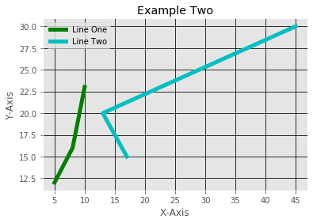
plt.title('Example Two')
plt.xlabel('X-Axis')
plt.ylabel('Y-Axis')
plt.legend()
plt.grid(True,color='k')
plt.show()

Slide 33
Bar Plot:
x1=[5,8,10]
y1=[12,16,23]
x2=[17,13,45]
y2=[15,20,30]
plt.bar(x1,y1,label='Example One')
plt.bar(x2,y2,label='Example Two')
plt.legend()
plt.xlabel('X-axis')
plt.ylabel('Y-axis')

Slide 34
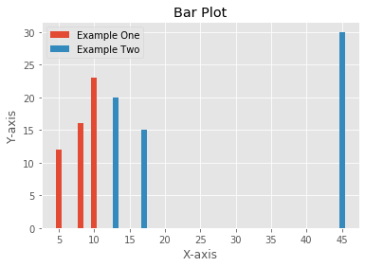
plt.title('Bar Plot')
plt.show()

Slide 35
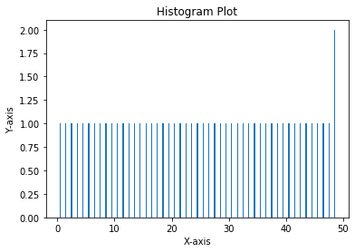
Histogram:
pa=range(50)
bins=range(50)
plt.hist(pa,bins,histtype='bar',rwidth=0.2)
plt.xlabel('X-axis')
plt.ylabel('Y-axis')
plt.title('Histogram Plot')
plt.show()

Slide 36
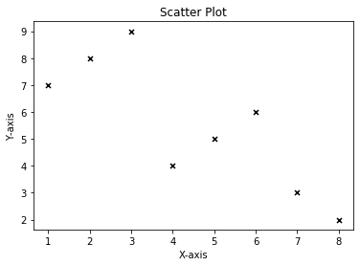
Scatter Plot:
x3=[1,2,3,4,5,6,7,8]
y3=[7,8,9,4,5,6,3,2]
plt.scatter(x3,y3,label='Arvind',color='k',s=25,marker='x')
plt.xlabel('X-axis')
plt.ylabel('Y-axis')
plt.title('Scatter Plot')
plt.show()

Slide 37
Stack Plot:
D=[1,2,3,4,5]
S=[7,8,6,11,7]
E=[2,3,4,3,2]
W=[7,8,7,2,2]
P=[8,5,7,8,13]
plt.plot([],[],color='m',label='D',linewidth=5)
plt.plot([],[],color='c',label='S',linewidth=5)
plt.plot([],[],color='r',label='E',linewidth=5)
plt.plot([],[],color='k',label='W',linewidth=5)
plt.plot([],[],color='g',label='P',linewidth=5)

Slide 38
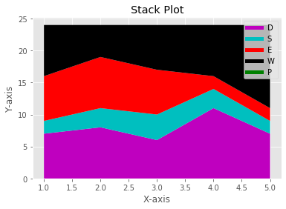
plt.stackplot(D,S,E,W,P,colors=['m','c','r','k','y'])
plt.legend()
plt.xlabel('X-axis')
plt.ylabel('Y-axis')
plt.title('Stack Plot')
plt.show()

Slide 39
Pie Plot:
slices=[7,2,4,3]
Name=['A','B','C','D']
clrs=['c','m','r','b']
plt.pie(slices,
labels=Name,
colors=clrs,
startangle=90,
shadow=True,
explode=(0,0.1,0,0),
autopct='%.2f%%'
)

Slide 40
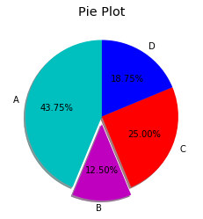
plt.title('Pie Plot')
plt.show()

Slide 41
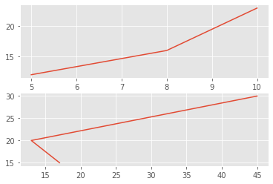
Working With Multiple Plots:
x1=[5,8,10]
y1=[12,16,23]
x2=[17,13,45]
y2=[15,20,30]
plt.subplot(211)
plt.plot(x1,y1)
plt.subplot(212)
plt.plot(x2,y2)
plt.show()

Slide 42
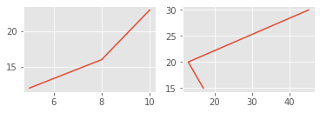
x1=[5,8,10]
y1=[12,16,23]
x2=[17,13,45]
y2=[15,20,30]
plt.subplot(221)
plt.plot(x1,y1)
plt.subplot(222)
plt.plot(x2,y2)
plt.show()

Slide 43
Plt.subplot(211)
2 means we have 2 plots in this plot.
1 means Horizontally we have only one plot
1 means this is plot number 1

